Slide 1
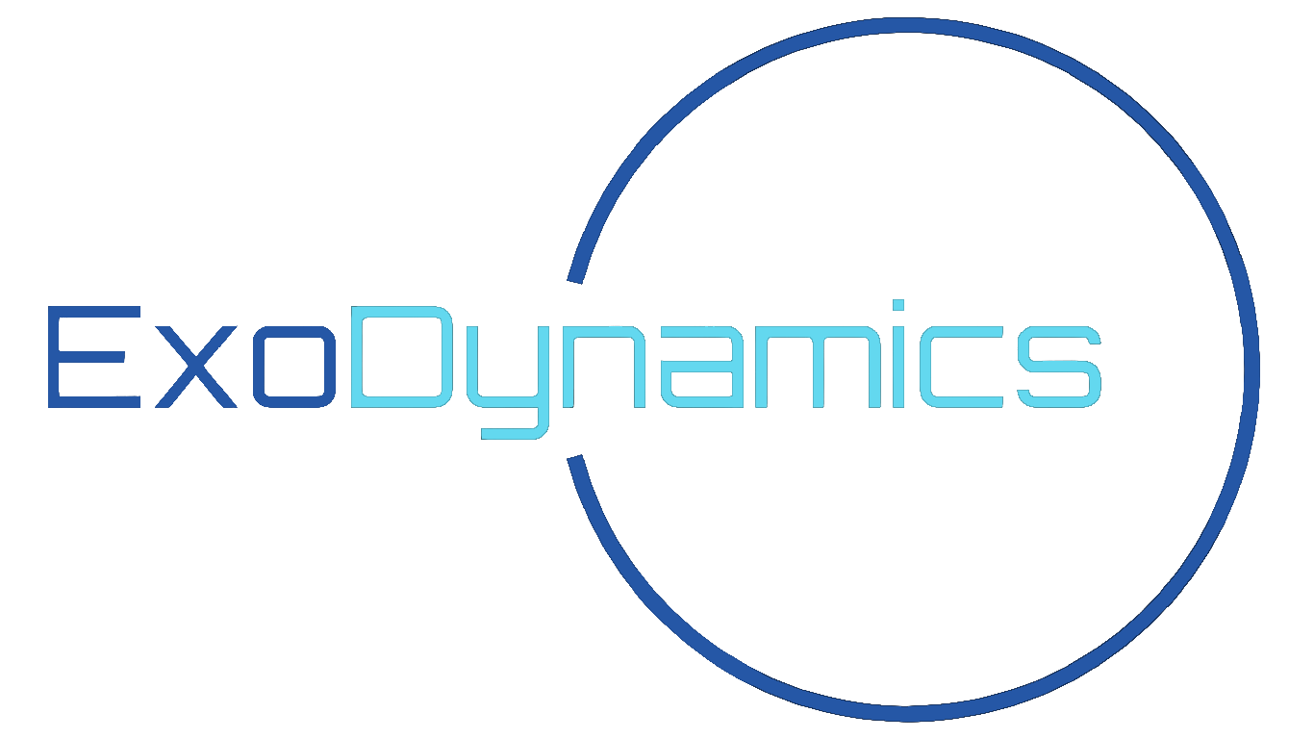
Enabling Limitless Movement for Knee Related Injuries
Notes:
Hello everyone, we are the team at ExoDynamics and what we bring to you today is a device unlike any other.

Slide 2
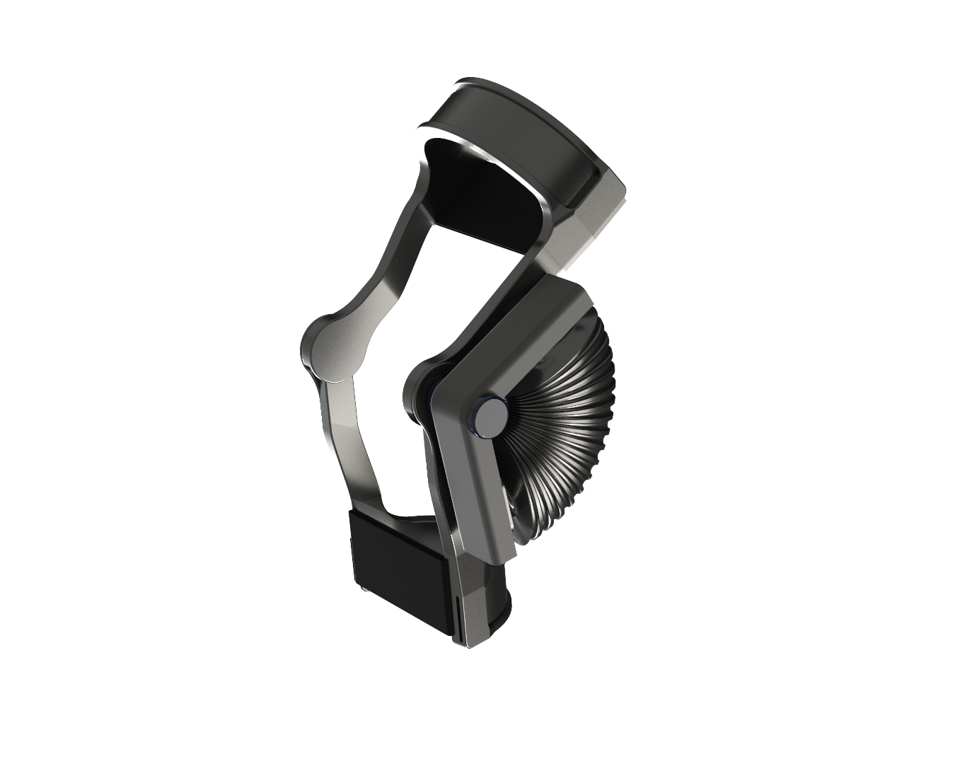
Strider MK. II
Never Before Seen
There is nothing like it on the market right now. Experience all the functionality of an exoskeleton in the familiar style of a knee brace.
Integrated Passive and Active Systems
The Strider remains operational even when there is no power. Our novel liquid spring system works around the clock so you don’t have to.
Customized to YOU
Every person is unique, and so is every purchase of the Strider. Each and every model is manufactured to your specific knee anatomy.
Notes:
This is Strider Mark 2.
It is an exoskeleton that is designed solely to support your specific knee anatomy by disturbing the load experienced on it; significantly reducing knee pain and increasing mobility.
It features an active and passive system that works in conjunction with each other to provide the utmost comfort when moving and remains operational even when not powered.
It is a solution that seeks to tackle the silent epidemic facing our community.

Slide 3



65%
25%
40%
52%
Knee Pains, Injuries, and Tears
Rise in knee pain over the past 20 years
Of adults are affected by knee pain
Of all sport injuries are related to the knee joint
More likely to develop knee osteoarthritis for those in physically demanding jobs
Notes:
Because quite frankly, knee pains, and often its related injuries are becoming more prevalent as our population gets older, as we get more active, and as obesity rates increase.
This has led to a rise of 65% in the past 20 years, with 1 in 4 adults today being affected by knee pains.
You become even more susceptible to these complications if you work in a physically demanding job. These are your firefighters, caretakers, and construction workers.
And for our athletes, research has found that upwards of 40% of all sports injuries occur at the knee joint, with ACL tears making up a good portion.

Slide 4
Market Sizing
ORTHOPEDIC KNEE DEVICE
11.5 Billion USD
U.S. AND EU MARKET
7.27 Billion USD
INSURED
6.95 Billion USD
1.37 Billion USD
TARGET DEMOGRAPHIC
Total Market Value: | 1.37 - 1.71 Billion USD
Notes:
It is no surprise then that the global ORTHOPEDIC DEVICE market for knees is valued at 11.5 Billion dollars, With the United States and the European Union capturing the largest market shares at just over 60% collectively.
Now given the nature of our device and our current price estimate of 10 thousand per unit, we would want to narrow the scope of our available market to just those who currently have health insurance
Finally, we would want to consider those who are actually looking for mobility aids.
The orthopedic knee device market can be split further split into 3 main categories: Knee Implants, Knee Braces, Arthroscopy Devices. Our exoskeleton can tap into all 3 of these fields but knee braces are our direct competitors and these are the type of customers we want to win over. It currently holds around 20%-25% of the market share.
Thus giving us a range of 1.37 to 1.71 billion dollar market size.

Slide 5

Strider MK. II
Carbon Fibre Frame
Integrated Liquid Spring Passive System
Pneumatic Active System
Elastic Straps
Notes:
So with the Strider, our team at ExoDynamics is transforming the space by introducing a first-of-its-kind knee exoskeleton that uses a passive and active system for knee mobility assistance. This adds a redundacy factor to our design, which ensures that users can feel comfortable with their brace to do what it needs to do. This is especially important as many people that have knee pain, their lives revolves around this and the discomfort persists over time. We want to be able to help people shift away their focus from their knee pain, and focus more on the things they love to do in their daily lives.
So the active system is a pneumatics driven which utlizes compressed air to inflate and deflate a "bag"as the user walks. So when the user extends their leg as they are walking or standing up, the Strider will detect this through sensors which will cause the "air bag" will inflate and provide an additional lifting force to the user, adding less stress to their knee joint.
In tandem, the passive system is using a liquid spring actuated system that is embedded into the carbon fibre frame of the exoskeleton. It works by the internal springs generating its own energy through knee flexion and releasing the potential energy to drives the knee joint for extension.
Overall, we hold paramount the safety and comfort of the people who use our device which is why why we custom fit every single strider for each individual customer.

Slide 6
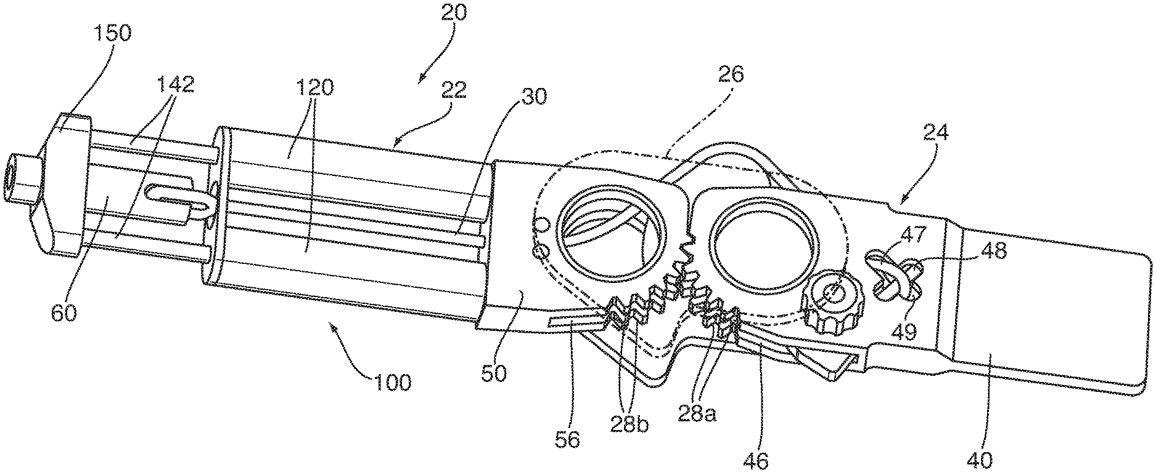
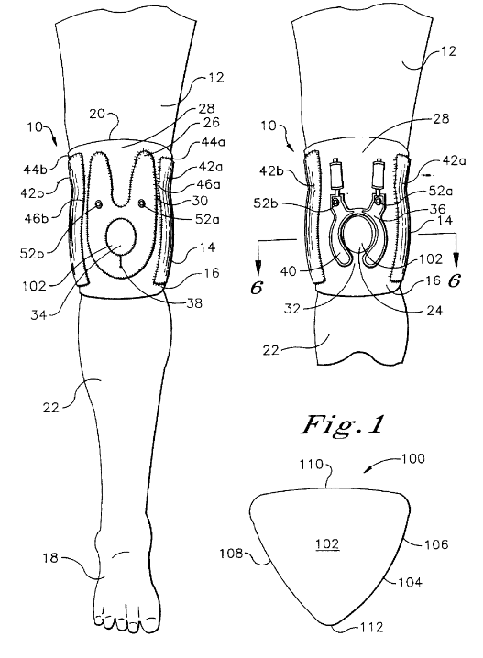
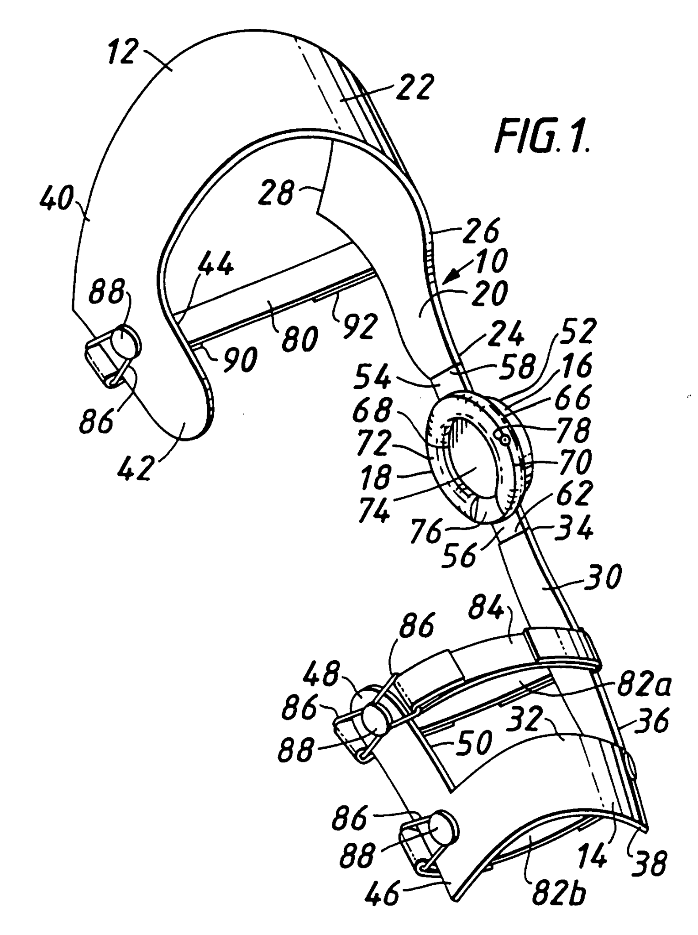
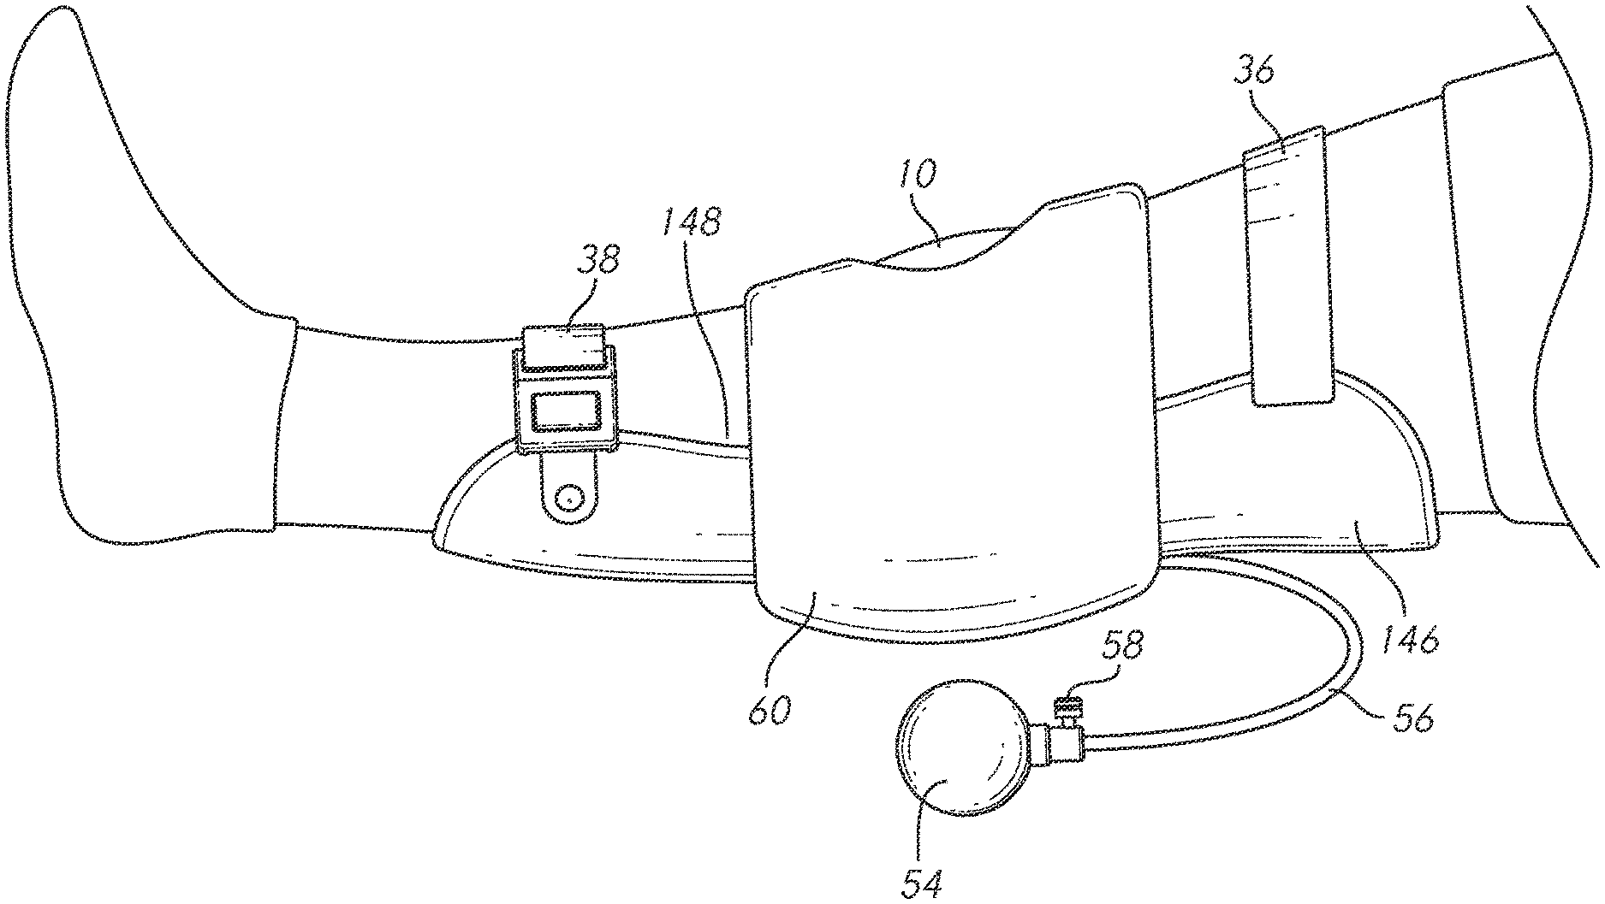

Intellectual Property (IP)
Patents that may pose a barrier to commercialization
✓ Conducted a “Freedom to Operate” search
✓ Diversified search queries to broaden search
✓ Strider Mark II has the freedom to operate
Expired Patents
Hinge for a brace (US11464661B2)
Soft inflatable exosuit for knee rehabilitation (US11259980B2)
Knee brace having an inflatable pad circumscribing the patella
(US5792084A)
Osteoarthritic knee brace
(EP0670152B1)
Notes:
We performed a detailed freedom to operate search to ensure our product is not breaching any claims in any patents. On the slide, you can see 2 patents that may be concerning but justify our commercization by proving our device uses a different mechanism to perform the same task. There were also patents that were concerning, but since they are expired, they will not be a problem.
So, currently we can conclude that the Strider has the freedom to operate. However, we will be doing our due diligence in conducting multiple FTO searches throughout our entire research and development process.

Slide 7



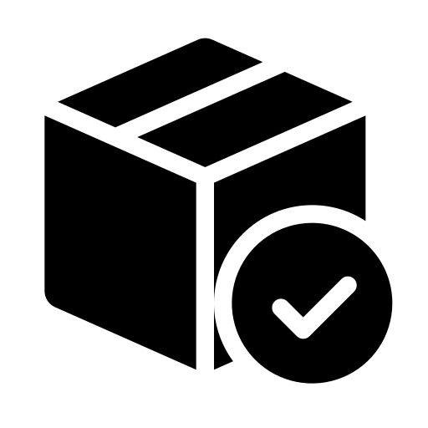
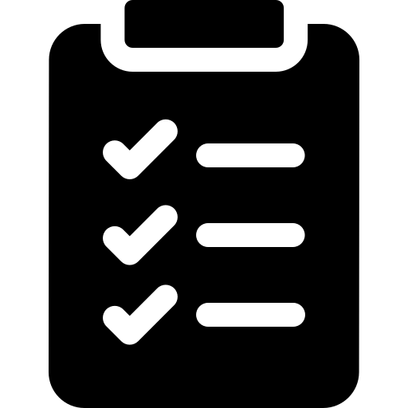
Equity Considerations
Accessibility
Affordability
Inclusivity
Availability
Accountability
Notes:
Accessibility: It's important to ensure that the Strider Mk2 is accessible to people with various mobility needs, including those who use wheelchairs or other mobility aids. The product should be designed in a way that makes it easy for people to use, regardless of their physical abilities. Again, this product is made specifically for individuals with knee-related injuries but there should not be a physical ability requirement.
Affordability: Cost is always an equity concern, and it's important to ensure that the Strider Mk2 is priced in a way that makes it accessible to as many people as possible. We could explore options like government funding or insurance coverage to make the product more affordable for users and even include multiple revenue streams as well.
Inclusivity: It's important to ensure that the Strider Mk2 is designed to meet the needs of people from diverse backgrounds, including people of different ages, genders, races, and ethnicities. The product should be designed to accommodate a wide range of body types and sizes.
Availability: The Strider Mk2 should be made available to people in all parts of the world, not just in wealthy countries. This can be challenging, given the cost of manufacturing and distribution as well as laws surrounding patents and medical devices, but it's important to ensure that the product doesn't create a "digital divide" where only certain groups of people have access to it.
Accountability: The Strider Mk2 should be designed to incorporate user feedback from people with different types of mobility challenges. User-centered design can help ensure that the product is accessible and effective for the people who need it most. Having feedback and support channels can help keep ExoDynamics as a company accountable as well.

Slide 8
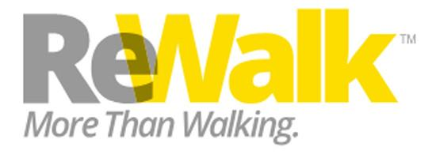

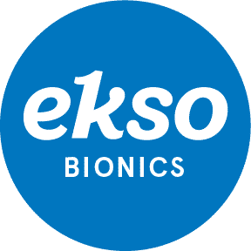
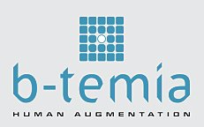
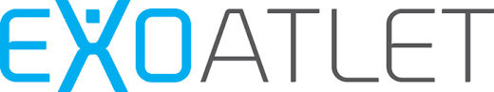
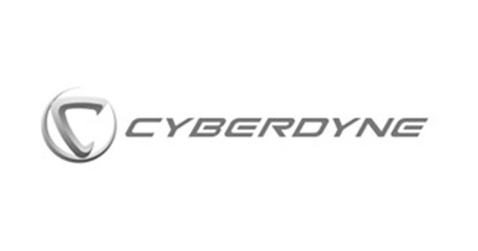
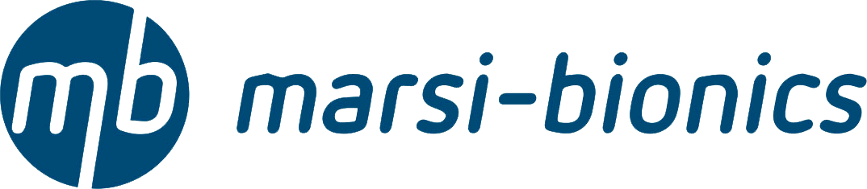

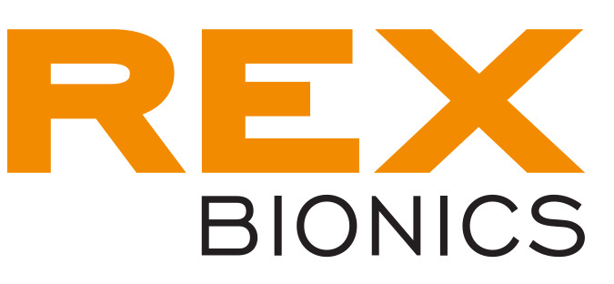

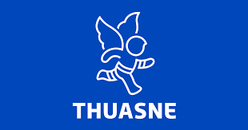

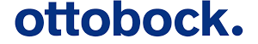

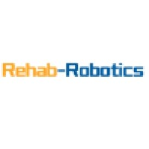
Petal Diagram
Sensor-based, motorized, and algorithm-driven
Electrical stimulation (NMES)
Braces for the knee joint
Unique movement systems
Notes:
Petal Diagram:
Based on extensive research, we have narrowed our list of competitors to 16 companies. As shown on the petal diagram, a majority of them can be classified under the “sensor-based, motorized, and algorithm-driven” petal. Whereas very few companies fit into the other petals: “Braces for the knee joint”, “Electrical stimulation (NMES)”, and “Unique movement systems”. This is indicative of the commonality of all these companies and their products. Although this search was not exhaustive, based on the ones we found, we can confidently say that our product will stand out amongst the competition.

Slide 9
Whitespace Diagram
 | Fail-Safe for Power Loss | Dual Activation System | Product Cost | Accompanying App
 | Device still usable if loss of battery / user is not harmed? | Adds redundancy to the system in case of failure | Low cost means more accessible for more people | Helps with control, various settings, and data analytics
ExoDynamics (Strider MkII) | Relies on secondary passive system | Dual system - pneumatic active system & liquid spring passive system | $10,000 | Strider Companion App
Ekso Bionics (Ekso Indego Personal) | Locking mechanism | Single system - motor-based active system | $100,000+ | Indego Therapy Assistant
ReWalk Robotics (ReWalk Robotics ReWalk Personal 6.0 Exoskeleton) | “Gravity Mode” maintaining a standing position & locking mechanism | Single system - motor-based active system | $77,000 | ReWalk Personal App
Cyberdyne (Hybrid Assistive Limb) | Manual mode & gradually and smoothly reduce the power assistance to zero | Single system - motor-based active system | $20,000 | HAL Connect
Notes:
Whitespace Diagram:
Our 3 biggest competitors are Ekso Bionics, ReWalk Robotics, and Cyberdyne. The Strider Mk2 stands out from the competition due to its unique dual activation system that offers both an active pneumatic system and a passive liquid spring system, which adds redundancy to the device in case of failure. It also has a relatively low cost compared to other exoskeletons on the market, making it more accessible to a wider range of people. The Strider Companion App also provides control, various settings, and data analytics to assist with user experience.
In contrast, the Ekso Indego Personal and ReWalk Robotics ReWalk Personal 6.0 Exoskeleton both use a single motor-based active system and have a higher cost, while the Cyberdyne Hybrid Assistive Limb has a unique manual mode but also uses a single motor-based active system.
Overall, the Strider Mk2 offers a unique and promising approach to lower limb exoskeleton technology, providing a dual activation system for added safety and a lower cost compared to other exoskeletons. Its accompanying app also offers added control and data analytics for a more personalized user experience.

Slide 10
Revenue
Streams
Proposed Revenue Model
$10,000 one time
Product Sale
$50 per use
5 years @ 3.1% = $180.13 monthly
Usage Fee
Product Leasing
Subscription
Maintenance Contracts
$500 - $1500 yearly
$50 - $200 monthly
Notes:
Product Sale: A one-time purchase price of $10,000 is our price point based on our competitive analysis.
Product Leasing: A lease term and interest rate of 5 years @ 3.1% leads to $180.13 monthly fee and a total interest gain of $807.90 is our proposed leasing model. In the future, based on further market research and demand, we may introduce shorter term leasing options.
Usage Fee: A pay-per-use price of $50 is what we concluded would be viable for individuals who are curious about our product and who may not have the funds for a one-time purchase or leasing. The pay-per-use pricing model could also be attractive to customers who may not need the exoskeleton for an extended period of time.
Subscription for Data Analytics: The ongoing recurring cost for the “smart” portion will be based on the level of data and analytics provided, as well as any additional features or support offered. As of right now, this feature will cost $50 - $200 per month and will include data such as control settings, resistance / actuation / motion values, daily use data, and daily progression data.
Maintenance/Support Contracts: The cost for maintenance and support contracts will be based on the level of service provided, as well as any additional costs associated with maintaining the equipment and support for repairs and inquiries. As it stands, we will have contract models ranging from $500 - $1500 yearly for maintenance and servicing support.
Could a revenue stream/price choice make it possible for decisions to be made lower in the org (and thus quicker)?
Offering our flexible pricing model that includes options such as leasing or pay-per-use pricing will make it possible for decisions to be made lower in interested organizations, and thus quicker. These pricing options would allow individual clinics, hospitals, or sports teams to more easily manage their budget and cash flow, which could make it easier for them to make a purchasing decision without needing to consult with higher-level decision-makers.
If your company should have more than one revenue stream, what would it or they be?
The following are the revenue streams we are considering: Product Sale, Usage Fee, Product Leasing, Maintenance / Support Contracts, and Subscriptions for data analytics.
In addition to the revenue streams mentioned, another potential revenue stream could be offering training and certification programs for clinicians or technicians who will be working with the exoskeleton. This could provide additional revenue and also help to ensure that the device is being used safely and effectively.
Orgs like consistent costs that can be budgeted - and your company likes reliable revenue. What revenue streams make both happy?
Revenue streams that offer consistent costs that can be budgeted for and provide reliable revenue could include product leasing or maintenance/support contracts with recurring payments. These revenue streams would allow customers to plan and budget for the costs associated with using the device, while also providing your company with predictable revenue streams.
If consumer product: what revenue streams do you think customers prefer?
As a medical device primarily intended for clinical use, this product is not necessarily a consumer product. However, if the device were to be marketed to individual consumers, revenue streams that customers may prefer could include a one-time purchase price, or a leasing model with additional features or services via the subscription.

Slide 11
Customer Decision Network
LEGEND:
Medical Device Suppliers
EXODYNAMICS
Private Insurers
Employers & Associations
Healthcare Providers
LONG-TERM CARE INSURANCE
MEDIGAP
PRIVATE RISK BEARING INSURANCE
Government Agencies
Consultants & Intermediaries
Government Insurers
SELF-INSURING EMPLOYEES
MEDICAL ASSOCIATIONS
NON SELF-INSURING EMPLOYEES
Service Recipient
BENEFICIARY
PUBLIC HOSPITALS
SPECIALTY CLINICS
PRIVATE HOSPITAL
NURSING HOMES
KEY:
INSPECTORS & LICENSING BOARDS
MEDPAC
STATE GOVERNMENT
Taxes
Money Transfer
Service Transfer
Decision Maker
BENEFIT CONSULTANTS
AGENTS & BROKERS
REVENUE CONSULTANTS
Economic Buyer
Recommender
Influencer
MEDICARE
End User
Notes:
The following decision network communicates how the product will reach into the hands of our customers. Our technology will be purchased directly by healthcare providers, who will recoup a portion of the money from beneficiaries. Medical associations will act as influencers that promote the purchase of our product. Lastly, funding from government agencies will provide financial support for purchase and implementation of our device in healthcare centres.

Slide 12
Regulatory Process
LOWER-LIMB EXOSKELETON MEDICAL DEVICE
CLASS II: MODERATE & CONTROLLED RISK
DE NOVO 510K: NO PREDICATE
GENERAL CONTROLS
SPECIAL CONTROLS
CLINICAL DATA
APPROVAL TO MARKET DEVICE
Notes:
Although our device does not require invasive implantation, it will semi-autonomously interface with patients on a regular basis. Hence, ExoDynamics will proceed with FDA clearance in the Class II category for moderate and controlled risk. As there are not many established predicates, the de novo 510k classification will be used for our regulatory pathway. After a set of clinical and specialized trials, we will receive approval to introduce our product into the market.

Slide 13




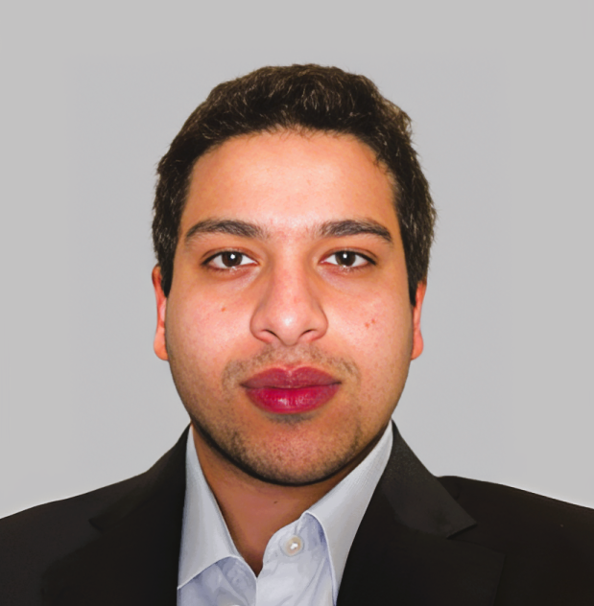

The ExoDynamics Team
Sam Chang
Patrick Cervantes
Amber Bhatt
Chief Executive Officer (CEO)
Chief Technology Officer (CTO)
Chief Financial Officer (CFO)
BASc. in Biomedical Engineering, UBC
BASc. in Biomedical Engineering, UBC
BASc. in Biomedical Engineering, UBC
3+ Years Experience in Biomechanics & Biomaterials
3+ Years Experience in Biomechanics & Biomaterials
3+ Years Experience in Bioinformatics
Aly Khan Nuruddin
Selim Akef
Vacant
Chief Medical Officer (CMO)
Chief Business Development Officer (CBDO)
Chief Sales Officer (CSO)
BASc. in Biomedical Engineering, UBC
BASc. in Biomedical Engineering, UBC
2+ Years Experience in Signals & Systems
3+ Years Experience in Signals & Systems
Notes:
Standing in front of you is our core team, with roles in management, finance, business development, technology and regulatory procedures. As we transition towards device commercialization, we will be looking to hire for the chief sales officer position as well.

Slide 14

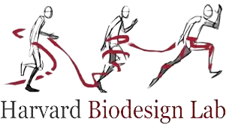

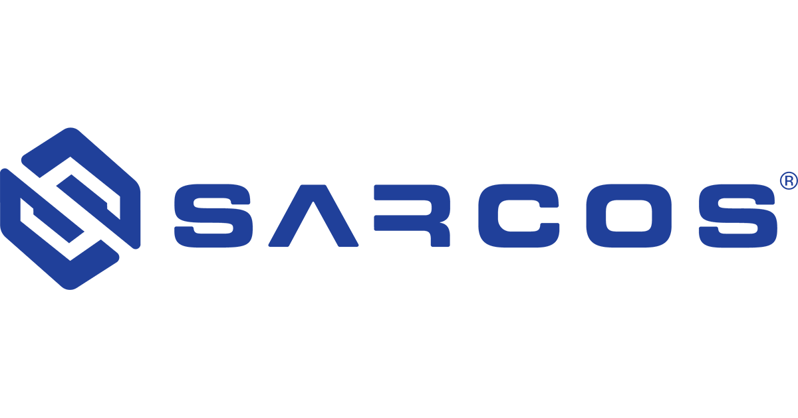







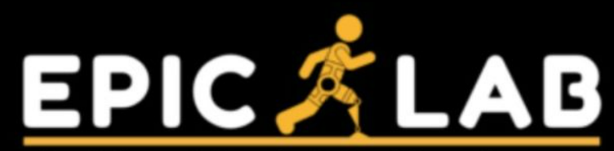
Our Expert Partners
Notes:
ExoDynamics has established several clinical and industry-based connections with experts in the following organizations.

Slide 15
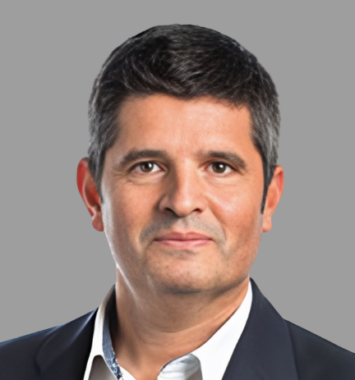

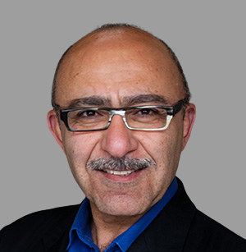
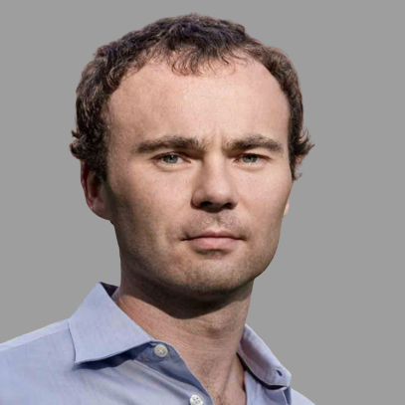


Clinical Advisors Team
Jose L. Pons, PhD.
Katherine J. Kuchenbecker, PhD.
Homayoon Kazerooni, PhD.
Director of Bioengineering, Northwestern University
Director of Haptic Intelligence, Max Planck Institute
Director of Robotics, University of California-Berkeley
Associate Editor, Frontier of Neurology Journal
Co-Chair, IEEE Committee on Haptic Feedback
Associate Editor, ASME Journal of Dynamics Systems
150+ Articles on Lower-Limb Neuroprosthetics
300+ Articles on Robot-Assisted Rehabilitation
200+ Articles on Human-Machine Design
Conor Walsh, PhD.
Myunghee Kim, PhD.
Aaron Young, PhD.
Director of Rehabilitation Sciences, Harvard University
Director of Rehabilitation Robotics, University of Illinois
Director of Robotics, Georgia Institute of Technology
Research Panel Chair, National Science Foundation
Co-Chair, Mechanical & Industrial Engineering Society
Research Panel Chair, National Robotics Initiative
120+ Articles on Exoskeleton Gait Mobility
160+ Articles on Assistive Robot Devices
100+ Articles on Augmented Biomechanics
Notes:
Our team of clinical advisors have over 15 years of academic experience in robot-assisted rehabilitation, and our highly familiar with the US-based market.

Slide 16
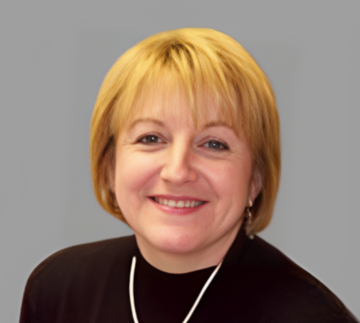
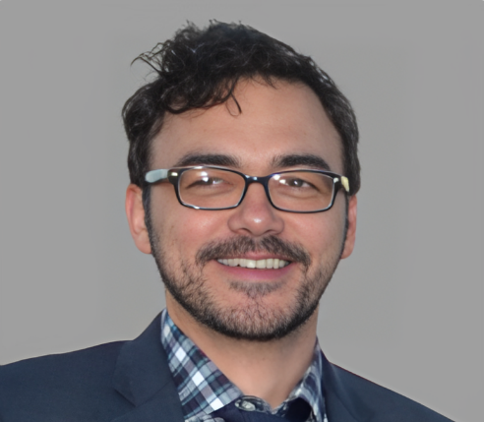
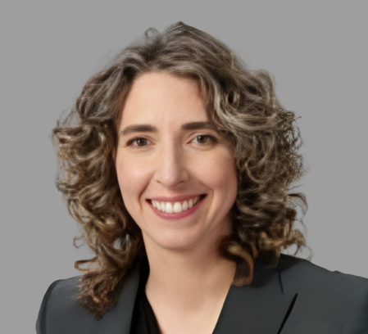

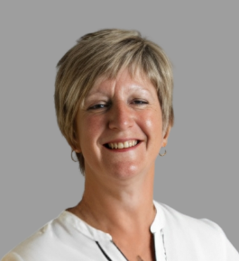
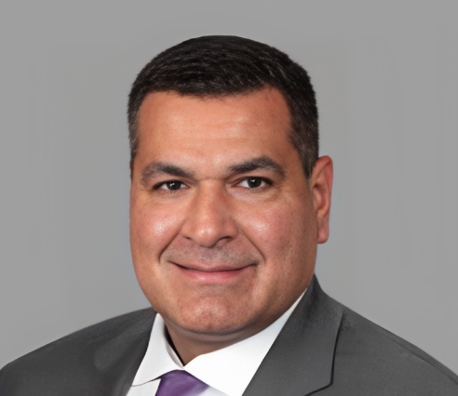
Industry Advisors Team
Dana Gaddy, MD.
Denis Garagić, MD.
Aimee S. Klapach, MD.
Director of Biological Sciences, Texas A&M University
Chief Technology Officer, Sarcos Technology & Robotics
Knee Surgeon, Abbott Northwestern Hospital
Former Gymnast, Runner, Swimmer & Skier
Former Chief Scientist, BAE Systems FAST Lab
Board Certified Specialist, Sports Medicine & Orthopaedics
Ruptured Anterior Cruciate & Medial Collateral Ligaments
25+ Years Experience in Advanced Systems & AI
20+ Years Experience in Ligament Reconstruction
Nicholas Kennedy, MD.
Jane Kreis
Anikar Chhabra, MD.
Orthopaedic Surgery Resident, Mayo Clinic
Consumer Safety Officer, Food & Drug Administration
Knee Surgeon, Scottsdale Shea Medical Centre
Former College Football & Basketball Player
Regional Training Officer, Office of Regulatory Affairs
Board Certified Specialist, Sports Medicine & Orthopaedics
Ruptured Anterior Cruciate & Fibular Collateral Ligaments
120+ Medical Device Inspections over 20 Years
20+ Years Experience in Ligament Reconstruction
Notes:
Meanwhile, our group of industry advisors, includes orthopaedic surgeons, a medical compliance officer at the FDA, a technologist at another robotics firm, as well as two doctors with sports-related knee injuries. Hence, our company will consult these individuals through various stages of the design process, to ensure that we provide you with the most comprehensive medical solution.

Slide 17
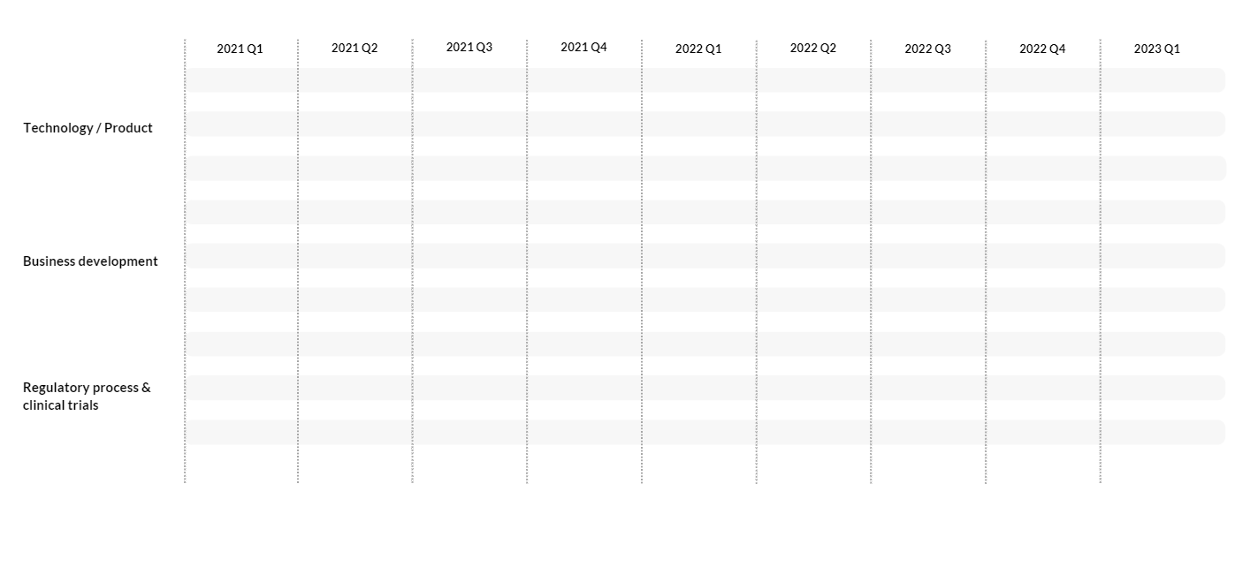
Venture Roadmap
Proof of concept
Alpha prototype
Beta prototype
V2 development
Testing
Validation
Testing
Validation
Testing
US product release
Income generation
EU product release
Market research
Manufacturing and inventory
Gather market data
Tech licensing research
Provisional patent
FDA class II
MDR class
De Novo 510(k)
CE mark active
Notes:
Here is a look at our venture roadmap.
At the beginning of the year, our team focused on conducting market research as well as the research for the necessary licensing needed in order to take our proof of concept and convert it into a fully functional design.
One of our most important objectives is to test and validate our alpha prototype in order to start stocking up on inventory.
Once the design is validated, we will further iterate the design into our beta prototype and start manufacturing.
And once we have gotten our approval from the FDA, we plan to launch our product immediately to the US market and start gathering additional market and consumer data in order to start the EU regulatory process to prepare for our EU launch with our new and improved v2 design.

Slide 18
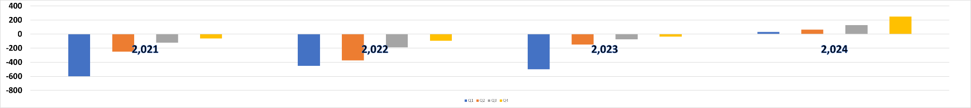
Costs and Cash Timeline
Proof of concept
Alpha prototype
Beta prototype
V2 development
V2 release
Testing
Validation
Testing
Validation
Testing
Income generation
US product release
EU product release
Market research
Manufacturing and inventory
Gather market data
Tech licensing research
Provisional patent
FDA class II
MDR class
De Novo 510(k)
CE mark active
Cash ($1000)
Notes:
This graph shows our cash needs for the next couple of years.
Based on our roadmap, we estimate to be burning through our cash reserves up until the final quarter of 2023.
We expect to start generating income as soon as our product is released on the US market
We anticipate allocating the bulk of our expenses towards research and development, materials and manufacturing, as well as general and marketing costs.
That is why we are asking for $1,550,000 broken down into three rounds of investing.
$600,000 in the first round
$450,000 in the second round
and an additional $500,000 in the round.
We expect to finally break-even early 2024 which coincides with our EU release, at which point we can start paying back our investors through dividends and buybacks.

Slide 19
Thank you!
Do you have any questions?
info@exodynamics.ca
+1 587-309-5189
www.exodynamics.ca

Slide 20
References
[1] U.-S. D. T. Nguyen, Y. Zhang, Y. Zhu, J. Niu, B. Zhang, and D. T. Felson, “Increasing prevalence of knee pain and symptomatic knee osteoarthritis: Survey and Cohort Data,” Annals of Internal Medicine, vol. 155, no. 11, p. 725, 2011.
[2] X. Wang, T. A. Perry, N. Arden, L. Chen, C. M. Parsons, C. Cooper, L. Gates, and D. J. Hunter, “Occupational risk in knee osteoarthritis: A systematic review and meta‐analysis of observational studies,” Arthritis Care &amp; Research, vol. 72, no. 9, pp. 1213–1223, 2020.
[3] P. Sancheti, M. Razi, E. B. Ramanathan, and P. Yung, “Injuries around the knee - symposium,” British Journal of Sports Medicine, vol. 44, no. Suppl_1, pp. i1–i1, 2010.
[4] Global Orthopedic Devices Market Size Report, 2030. [Online]. Available: https://www.grandviewresearch.com/industry-analysis/orthopedic-devices-market.
[5] Orthopedic Devices - Worldwide, , n.d.. [Online]. Available: https://www.statista.com/outlook/hmo/medical-technology/medical-devices/orthopedic-devices/worldwide?currency=usd
[6] Percentage of people with any health insurance in the United States from 1990 to 2021 [Graph], US Census Bureau, September 13, 2022. [Online]. Available: https://www.statista.com/statistics/200958/percentage-of-americans-with-health-insurance/
[7] “European health insurance options,” International Citizens Insurance, 29-Nov-2021. [Online]. Available: https://www.internationalinsurance.com/health/europe/.
[8] “Ottobock: Neck,” Amazon.de. [Online]. Available: https://www.amazon.de/stores/page/3072CE5E-6368-4AF4-82AB-23CE4D3DBAF7?ingress=2&amp;visitId=fee0b784-1c3d-4b23-8a70-8aeda3916ef4&amp;ref_=ast_bln.
[9] “How much does an exoskeleton cost?,” Cost Charts, 03-May-2017. [Online]. Available: https://costcharts.com/exoskeleton/. [Accessed: 04-Apr-2023].
[10] “Cyberdyne,” CYBERDYNE. [Online]. Available: https://www.cyberdyne.jp/english/products/LowerLimb_medical.html.
[11] “Ekso Indego personal,” Ekso Bionics, 21-Mar-2023. [Online]. Available: https://eksobionics.com/indego-personal/.
[12] “H-mex,” Exoskeleton Report, 23-Aug-2022. [Online]. Available: https://exoskeletonreport.com/product/h-mex/.

Slide 21
References Cont.
[13] “Rewalk™ Personal 6.0 exoskeleton for Spinal Cord Injury,” ReWalk Robotics, Inc., 07-Mar-2023. [Online]. Available: https://rewalk.com/rewalk-personal-3/.
[14] “Atalante X: A new kind of rehabilitation,” Atalante X | A new kind of rehabilitation. [Online]. Available: https://en.wandercraft.eu/.
[15] “KneeStim™,” Articulate Labs. [Online]. Available: https://articulatelabs.tech/kneestim-wearable-medical-device.
[16] “Indego: Powering people forward,” Parker Hannifin Corporation. [Online]. Available: https://www.indego.com/indego/us/en/home.
[17] “Reimagining rehabilitation,” Rex Bionics, 18-Jan-2020. [Online]. Available: https://www.rexbionics.com/.
[18] “Product page- EAII,” ExoAtlet, 11-Mar-2022. [Online]. Available: https://exoatlet.lu/product-page-exoatlet-ii/.
[19] “LegTutor,” MediTouch, 19-Sep-2021. [Online]. Available: https://meditouch.co.il/products/legtutor/.
[20] “Rebel reliever®,” Rebel Reliever® | Thuasne (EN). [Online]. Available: https://www.thuasne.com/en/rebel-relieverr.
[21] Marsibionics, “MB-Active Knee,” Marsi Bionics, 12-Mar-2020. [Online]. Available: https://www.marsibionics.com/en/mb-active-knee/.
[22] Rehab-Robotics Company Limited ,Rehab. [Online]. Available: https://www.rehab-robotics.com.hk/kineto/Kineto_lower.html.
[23] “Keeogo - B-temia,” B-Temia, 26-May-2022. [Online]. Available: https://b-temia.com/keeogo/.
[24] “Paexo soft knee by Ottobock,” Ottobock Bionic Exoskeletons, 21-Dec-2022. [Online]. Available: https://ottobockexoskeletons.com/paexo-soft-knee/?lang=en.
[25] “Phoenix,” suitx. [Online]. Available: https://www.suitx.com/phoenix.
[26] “Center for Devices and Radiological Health”. Medical Devices [Online]. U.S. Food and Drug Administration. FDA; Available: https://www.fda.gov/medical-devices

Slide 22
Appendix

Slide 23
Value Proposition Canvas: Knee Related Injuries
Enhances mobility; Active Lifestyle
Ability to continue working or participating in desired activities
Participation in work, sports, and recreational activities
Increased independence and self-reliance
Exoskeleton designed to alleviate knee pain
Increased independence & QOL
Maintain mobility despite knee pain
Improved quality of life
Durable, lightweight materials for comfort and ease of use
Participate in sports and recreational activities
Maintenance and repair services
Knee support and pain relief during movement
Chronic knee pain and discomfort
Work in physically demanding jobs
Customizable fit and support levels
Reduces stress on the knee joint, preventing further injury
Financial burden of medical treatments and therapies
Adjustable settings to accommodate different levels of pain and support needs
Fear of further injury or worsening condition

Slide 24
Market Sizing
Global Orthopedic Device Market | 40.88 Billion USD
Knee Market Share | 28.2%
Global Orthopedic Knee Devices Market | 11.5 Billion USD
ORTHOPEDIC KNEE DEVICE
U.S. Market Share | 33.3%
U.S. Knee Devices Market | 3.83 B USD
EU Market Share | 29.9%
EU Knee Devices Market | 3.44 B USD
U.S. AND EU MARKET
INSURED
U.S. Insured % | 91.7%
U.S. Insured | 3.51 B USD
EU Insured % | 100%
EU Insured | 3.44 B USD
TARGET DEMOGRAPHIC
Knee Implants | 60-70%
Knee Brace | 20-25%
Arthroscopy Devices | 10-15%
Total Market Value | 1.39 - 1.73 Billion USD
Notes:
The nature of our device and the problem we are trying to solve puts our product under the umbrella of the Orthopedic Device Market, which was worth 40.88 billion USD globally in 2021. This market consists of many different medical devices such as casts, wheelchairs, and surgical titanium plates; all of which do not apply to our company when calculating our product’s market size. We would need to limit the scope to just knee-related orthopedic devices. TAM: Our total addressable market would be focused on the global market share of medical knee devices. This gives us a value of 11.5 billion USD which is 28.2% of the total Orthopedic Device Market.
SAM: As we are based in the West, we can feasibility those in the U.S. and EU markets which account for over 60% of the total Orthopedic Device Market. We can make the assumption that this percentage breakdown holds when looking at our TAM. This will give us a served available market size of 3.83 billion USD and 3.44 billion USD for the U.S. and EU respectively.
SOM: Finally our serviceable obtainable market will most likely apply to those who have health insurance and are actually looking for mobility aids. This is due to the price tag of our device which currently sits at around 10,000 USD. Such a purchase will deter those who aren’t insured as they will be paying out of pocket. As of 2021, about 91.7% of the U.S. population has some form of health insurance be it private or public. As for the EU market, they have a universal healthcare system that can cover the cost of the Strider.
We are also considering our target demographic. The Orthopedic Knee Devices Market can be split into 3 main categories: knee implants, knee braces, and arthroscopy devices. Our exoskeleton can tap into all 3 of these fields as our product can serve as an accessory item to patients after having undergone surgery. Of course, the reasoning can be applied to knee braces which makes them our direct competitors and the type of customers we want to win over. Currently, the breakdown of each market is as follows: Knee Implants: 60-70%
Knee Brace: 20-25%
Arthroscopy Devices: 10-15%
Our final market size evaluation comes out to be a range of 1.37-1.71 billion USD when accounting for the lower and upper bound of the knee brace segment.

Slide 25
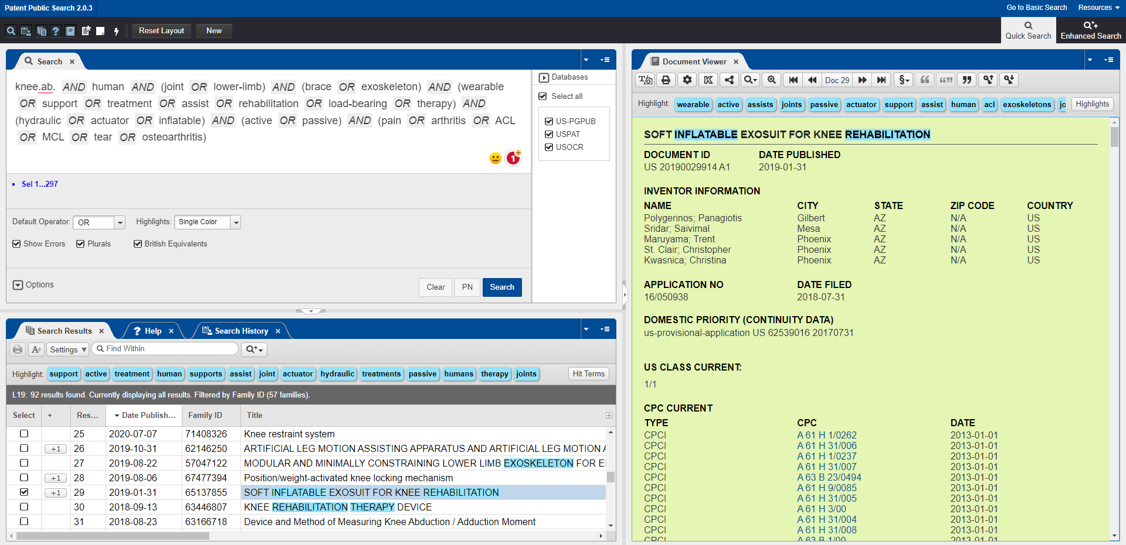

Freedom to Operate Search Example
USPTO - Patent Public Search

Slide 26
Competitive Landscape Research
Cyberdyne | - Sensors to detect electrical signals in muscles - Computer system interprets signals and controls electric motors that drive joint motion - Battery powered for electric motors
Wandercraft | - Motorized joints and sensors - Motors at the hip, knee, and ankle joints, which are controlled by a wearable remote control - Adjustable to fit different body types and is modular - Currently undergoing clinical trials in Europe
Esko Bionics | - Sensors that detect the user's movements and weight shifts - Computer system on waist interprets signals and controls motors - Battery powered, but is also removable
Articulate Labs Inc | - Uses electrical stimulation to activate specific muscle groups around the knee joint, helping to improve knee function and reduce pain - Sensors that detect the user's movements and adjust the stimulation patterns and intensity accordingly - Includes an app that allows users to track their progress and adjust settings, as well as access instructional videos and other resources
Hyundai Medical Exoskeleton (H-MEX) | - Sensors that detect the user's movements and weight shifts - Computer system on waist interprets signals and controls motors - Still in development phase
ReWalk Robotics | - Sensors that detect changes in the user's posture and balance, allowing it to adjust its movements and maintain stability - Motors that provide powered movement to the hip and knee joints - Controlled using a wearable remote control that the user can activate to stand up, walk, turn, and sit down - Using crutches or other assistive devices for support
Notes:
[8] “Cyberdyne,” CYBERDYNE. [Online]. Available: https://www.cyberdyne.jp/english/products/LowerLimb_medical.html.
[9] “Ekso Indego personal,” Ekso Bionics, 21-Mar-2023. [Online]. Available: https://eksobionics.com/indego-personal/.
[10] “H-mex,” Exoskeleton Report, 23-Aug-2022. [Online]. Available: https://exoskeletonreport.com/product/h-mex/.
[11] “Rewalk™ Personal 6.0 exoskeleton for Spinal Cord Injury,” ReWalk Robotics, Inc., 07-Mar-2023. [Online]. Available: https://rewalk.com/rewalk-personal-3/.
[12] “Atalante X: A new kind of rehabilitation,” Atalante X | A new kind of rehabilitation. [Online]. Available: https://en.wandercraft.eu/.
[13] “KneeStim™,” Articulate Labs. [Online]. Available: https://articulatelabs.tech/kneestim-wearable-medical-device.

Slide 27
Competitive Landscape Research Cont.
Indego | - Sensors and motors to detect the user's movement intentions and provide powered assistance for walking and standing - Connected to a control unit worn around the waist and a backpack-style power source - Sensors detect the movement and send a signal to the motors to provide assistance in lifting the leg and placing it forward
Meditouch | - Biofeedback technology to guide patients through exercises and provide real-time feedback on their movements and progress - Adjustable to fit patients of different sizes and can be used with both legs - Control box that contains sensors and motors
Rex Bionics Ltd | - Hands-free control system that allows users to initiate movements and adjust settings using body movements like weight-shifting or leaning forward - Sensors, motors, and software algorithms to detect the user's movement intentions and provide powered assistance for walking and standing
Thuasne | - Dynamic compression to help reduce pain and improve function - Adjustable hinge system allows the user to control the amount of support and flexibility provided by the brace
ExoAtlet | - Backpack containing the control unit and power source - Sensors, motors, and software algorithms to detect the user's movement intentions and provide powered assistance for walking and standing - Controlled by a therapist using a tablet-based interface, allowing for real-time adjustment of assistance level and gait parameters - Designed to be used in rehabilitation settings
Notes:
[14] “Indego: Powering people forward,” Parker Hannifin Corporation. [Online]. Available: https://www.indego.com/indego/us/en/home.
[15] “Reimagining rehabilitation,” Rex Bionics, 18-Jan-2020. [Online]. Available: https://www.rexbionics.com/.
[16] “Product page- EAII,” ExoAtlet, 11-Mar-2022. [Online]. Available: https://exoatlet.lu/product-page-exoatlet-ii/.
[17] “LegTutor,” MediTouch, 19-Sep-2021. [Online]. Available: https://meditouch.co.il/products/legtutor/.
[18] “Rebel reliever®,” Rebel Reliever® | Thuasne (EN). [Online]. Available: https://www.thuasne.com/en/rebel-relieverr.

Slide 28
Competitive Landscape Research Cont.
MarsiBionics | - Lithium-ion battery for power - Bluetooth connectivity for smartphone app control - Sensors, motors, and software algorithms to detect the user's movement intentions and adjusts the resistance of the knee joint in real time
Rehab-Robotics Company Limited | - Mechanical linkage system for adjusting the angle of the knee joint - Knob or lever for adjusting the angle of the knee joint - The angle of the knee joint can be locked in place to provide stability during physical activities
SuitX | - Several components, including a hip module, thigh module, knee module, and foot module, which can be combined and adjusted to fit the user's individual needs - Controlled by a wireless remote that allows the user to adjust the level of assistance provided by the device - Powerful motors to provide assistance to the user's lower limbs, helping them to stand up, walk, etc - Advanced sensors and algorithms to adapt to the user's movements in real-time, providing a more natural and intuitive experience - Unique feature is its "quick release" mechanism, which allows the user to easily detach and reattach the exoskeleton components for greater flexibility and convenience
B-Temia | - Sensors, motors, and software algorithms to detect the user's movement intentions and provide powered assistance for walking and standing - Backpack containing the control unit and power source - Unique "stair mode" allows the device to detect when the user is climbing stairs and adjust the assistance provided accordingly
Ottobock | - Sensors that detect the user's movements - Passive spring-based mechanical system
Notes:
[19] Marsibionics, “MB-Active Knee,” Marsi Bionics, 12-Mar-2020. [Online]. Available: https://www.marsibionics.com/en/mb-active-knee/.
[20] Rehab-Robotics Company Limited ,Rehab. [Online]. Available: https://www.rehab-robotics.com.hk/kineto/Kineto_lower.html.
[21] “Keeogo - B-temia,” B-Temia, 26-May-2022. [Online]. Available: https://b-temia.com/keeogo/.
[22] “Paexo soft knee by Ottobock,” Ottobock Bionic Exoskeletons, 21-Dec-2022. [Online]. Available: https://ottobockexoskeletons.com/paexo-soft-knee/?lang=en.
[23] “Phoenix,” suitx. [Online]. Available: https://www.suitx.com/phoenix.

Slide 29
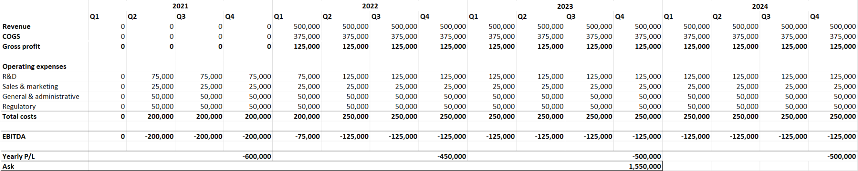
Costs and Cash Analysis

